Slide 1
The Data Science Process
Dr. Muhammad Nouman Durrani
Acknowledgement : Dr. Zeeshan Ahmed

Slide 2
Data Science Process
DS Process
Setting the reseach goal
Retrieving data
The process is NOT linear
but we often regress
and reiterate
Data preparation
Data exploration
Data modeling
Presentation and automation

Slide 3
1. Setting the Research Goal
A project starts by the WHAT, the Why and the HOW?
Outcome of first phase:
  Research goal
  Understanding of the context
  Project plan with well-defined milestones
  List of deliverables
Involves Senior personnel
Outcome: A project charter
Notes:
Understanding buiseness goals and context is essential

Slide 4
1. Setting the Research Goal
Research goal
  Understanding buiseness goals and context is essential
    Data sceintists often fail to understand buisness goals
  Take this phase seriously
    Spend more time
    Involve people with domain expertise

Slide 5
1. Setting the Research Goal
Project charter
  A clear research goal
  The project mission and context
  How analysis will be done?
  Resources required
  Proof that it is a achievable project or proof of concept
  List of Deliverables
  Timeline

Slide 6
2. Retrieving Data
Start with data available internally
  Most companies manage data about their activities
    Databases, data warehouse, flat files, workbooks and even hard copies
  Access to internal data depends upon company policies and politics

Slide 7
2. Retrieving Data
Getting data from other sources
  Data available online
  Data published by companies and research labs
  Often this data is of good quality
Quality check
  It is often easy to spot errors at this stage
  Make sure that data is of right data type and it is in the right format

Slide 8
3. Data Preparation
Data cleansing
  Errors from data entry
  Impossible values
  Missing values
  Outliers
  Spaces, typos…etc
  Error against codebook
Notes:
A codebook describes the layout of the data in the data file and describes what the data codes mean. Codebooks are used to document the values associated with the answer options for a given survey question.

Slide 9
3. Data Preparation
Data transformation
  Aggregating data
  Extrapolating data
  Derived measures
  Creating dummies
  Reducing number of vairables
Notes:
Extrapolation is the process of taking data values at points x₁, ..., x_{n}, and approximating a value outside the range of the given points.

Slide 10
3. Data Preparation
Combining data
  Merging / joining data sets
  Set operators
  Creating views

Slide 11
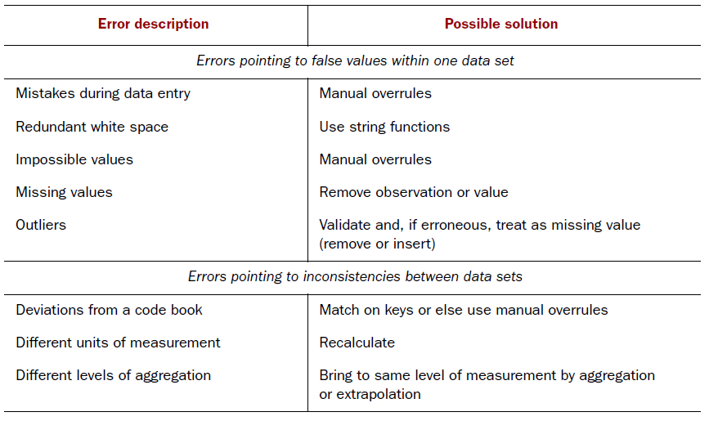
3. Data Preparation – Cleansing Data
(removing errors in data)
Diagnostic plots can be very useful in detecting these errors

Slide 12
3. Data Preparation – Cleansing Data
(removing errors in data)
Data entry errors
  Typing mistakes
  Errors during transmission
  Errors in extract, transform, and load phase (ETL)
  For small data sets corrections can be done manually
  For large data sets short scripts can be written to detect and correct errors

Slide 13
3. Data Preparation – Cleansing Data
(removing errors in data)
Sanity checks
  Check for incorrect values
  Check for out of range values
  Check for data type mismatch
  Often these checks can be easily enforced in Programs

Slide 14
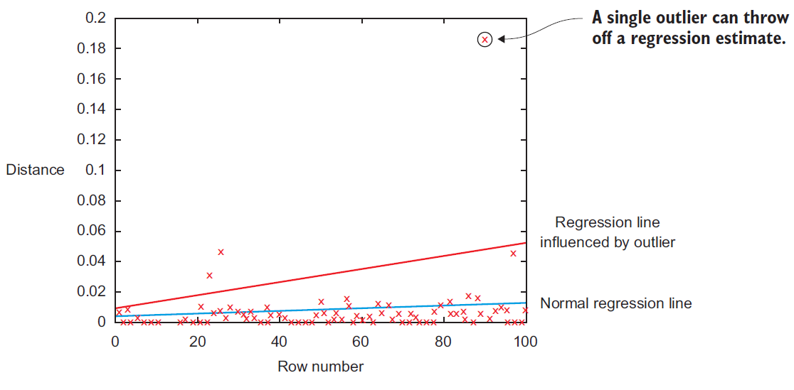
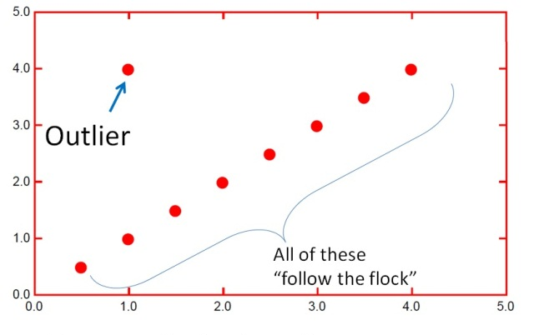
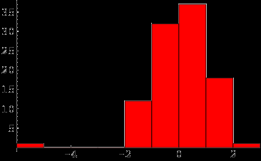
3. Data Preparation – Cleansing Data
(removing errors in data)
Outliers
  An outlier is an observation that does not follow the normal pattern, i.e. more distant from normal observations
  The easiest way to detect outliers is to use a data plot

Slide 15
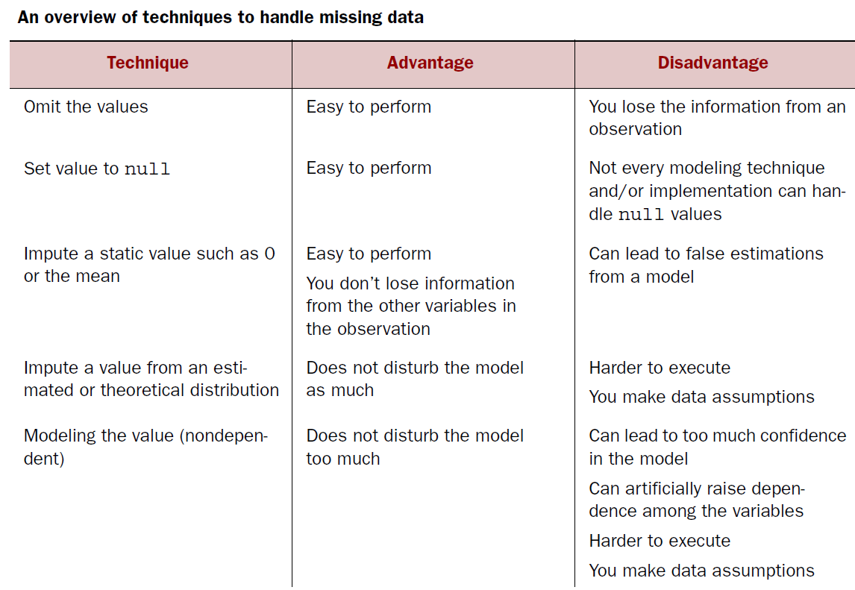
3. Data Preparation – Cleansing Data
(removing errors in data)

Slide 16
4. Exploratory Data Analysis
EDA usually employs graphical techniques to get better understanding of data, such as Histograms, Line charts, Box plots etc.
  However, some other techniques like tabulation, clustering, simple model building can also be used
Often undetected errors in data are discovered here

Slide 17
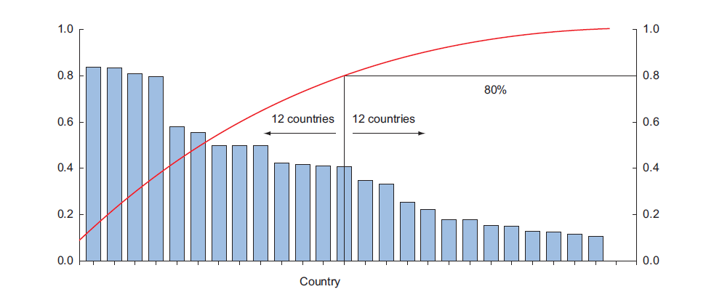
4. Exploratory Data Analysis
Overlay plots is also a useful EDA technique, such as Pareto diagram

Slide 18
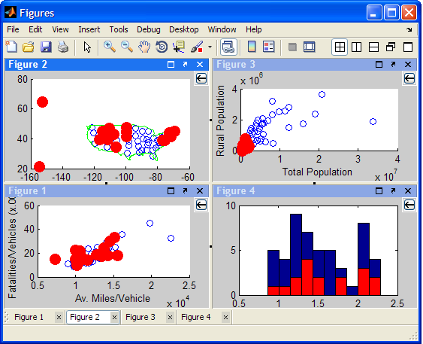
4. Exploratory Data Analysis
Brushing and Linking (IVA)

Slide 19
5. Build the Models
The goal is to build models to do prediction, classification, or clustering on given data
Involves machine learning, data mining and statistical techniques
Three main steps
  Model and variable selection
  Model execution
  Model diagnostic and model comparison

Slide 20
5. Build the Models – Model and Variable Selection
After EDA, we have an idea of variables that could be useful in constructing the model
Proper model selection requires expertise
Need to consider model Performance
Model selection must also consider project characteristics and limitations

Slide 21
5. Build the Models – Model and Variable Selection
Other factors to consider
  Must the model be moved to a production environment and, if so, would it be easy to implement?
  How difficult is the maintenance on the model: how long will it remain relevant if left untouched?
  Does the model need to be easy to explain?
We will start implementing our first models from Week 3

Slide 22
6. Presentation and Automation
Presenting your results to the stakeholders and industrializing your analysis process for repetitive reuse and integration with other tools.
  Needs to automate our model
Presenting results of your hard work needs SOFT skills
  Correctly presenting your results is as important as the modeling task itself

Slide 23
QUESTIONS???

